Slide 1
Week 3
SQL Review part 2

Slide 2
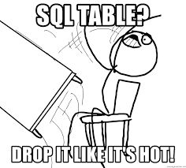
Table joins
Data is organized in tables
Tables will have a primary key for each item/record that is unique
Joining tables is so that you can get data from two tables
There are different types of joins depending how you want your data presented
The relationship of the tables is based on the primary key and foreign key
Joins are typically done between primary and foreign keys, but can involve other values as well
To have a join, you need a related column otherwise the join won't know how to work.

Slide 3
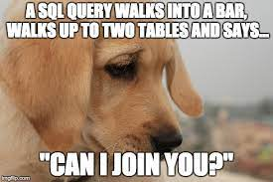
Examples of Table joins
Let's say we have a table of books and a table of library patrons
From what we know about SQL so far we can look at the contents of each table individually and manipulate the data on each single table
Adding in joins allows us to look at combos, such as who borrowed a book or the borrowing history of each patron

Slide 4
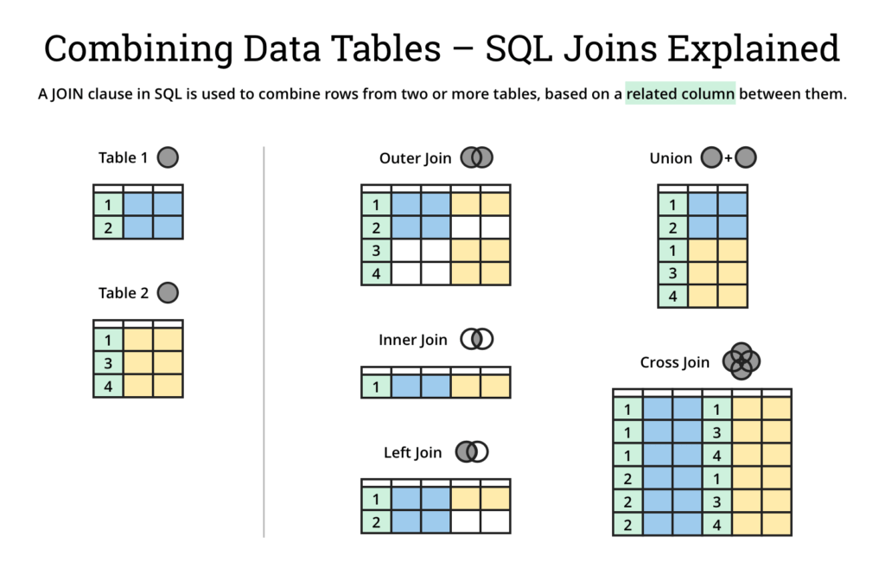
Visual Representation of joins
https://www.atlassian.com/data/sql/sql-join-types-explained-visually

Slide 5
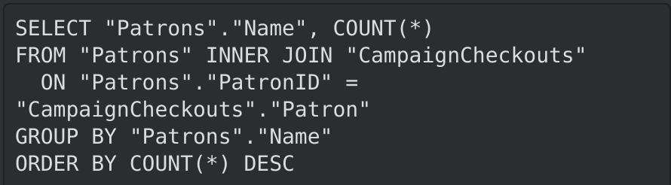
Why do we have so many table join types
Tables will have different relationships
The results of the different joins will show combinations of data
Depending on the problem we're trying to solve with our query we might need different combos of the data
For example, maybe we want to see the winner of a reading campaign. If we have a table of library patrons who signed up, and a table of books checked out for the campaign, we can do an inner join on them to see who the winner of the campaign is by ordering the results by descending(desc)

Slide 6
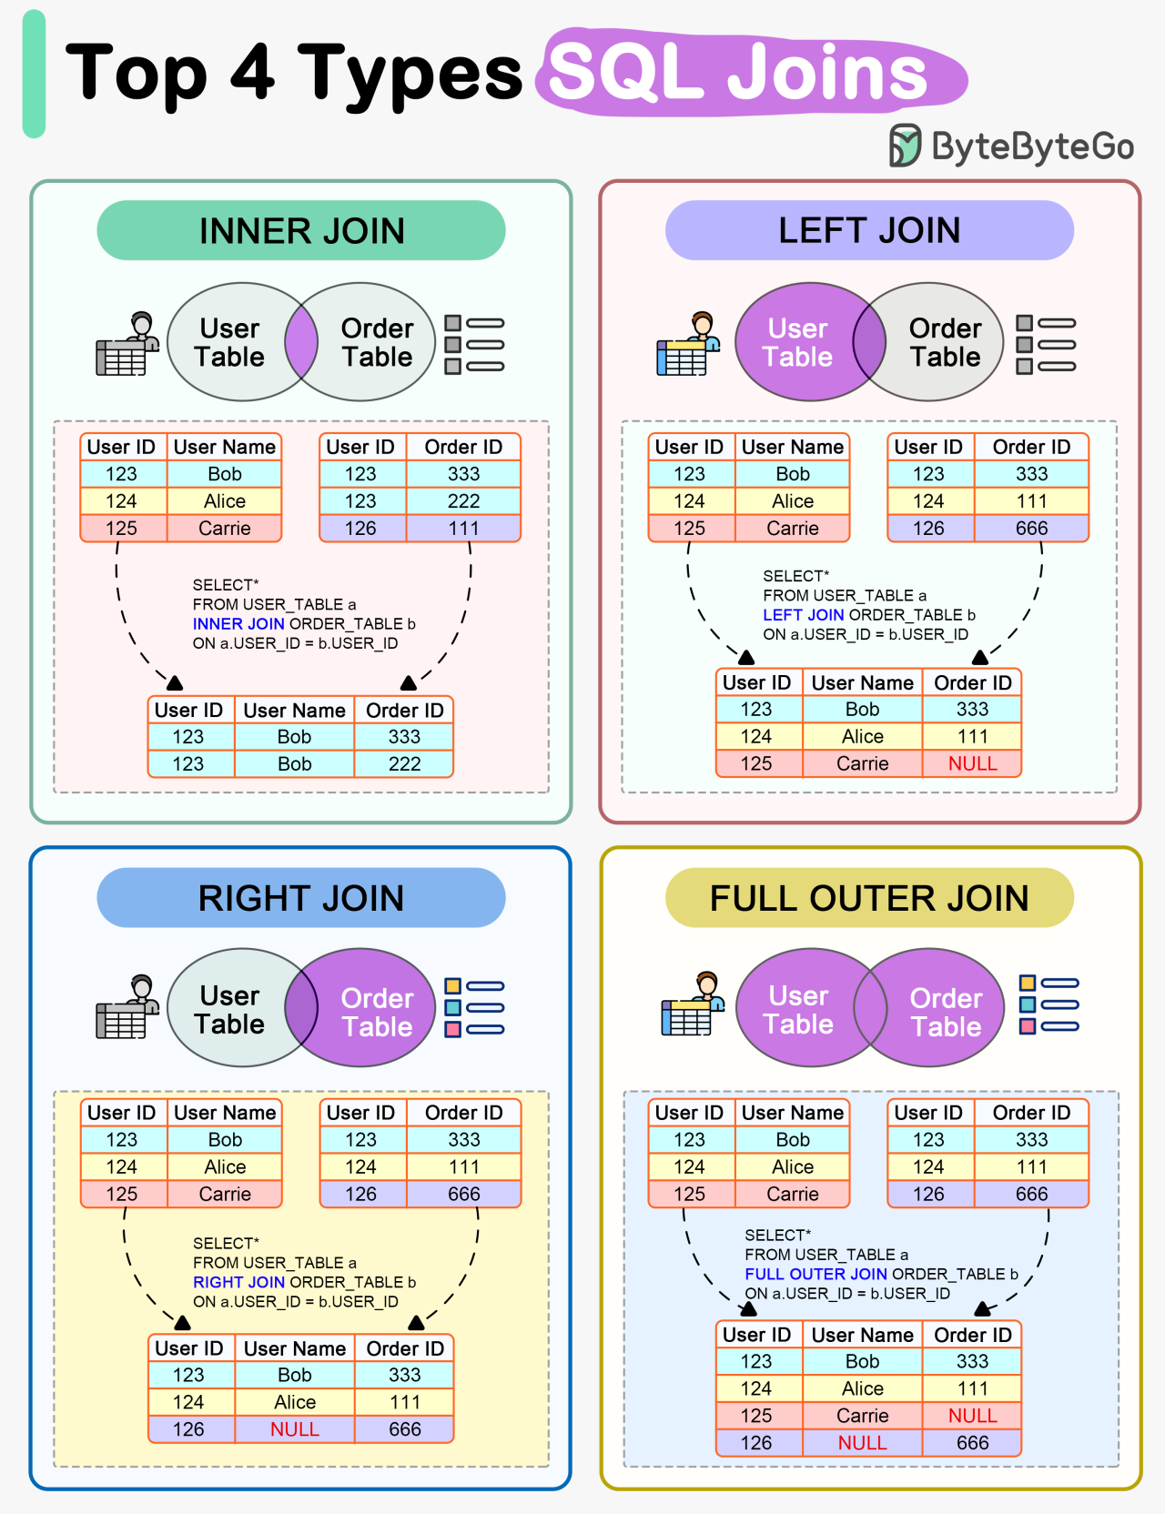

Visual of the types
http://www.differencebetween.net/technology/software-technology/difference-between-join-and-inner-join/
https://blog.bytebytego.com/p/ep90-how-do-sql-joins-work

Slide 7
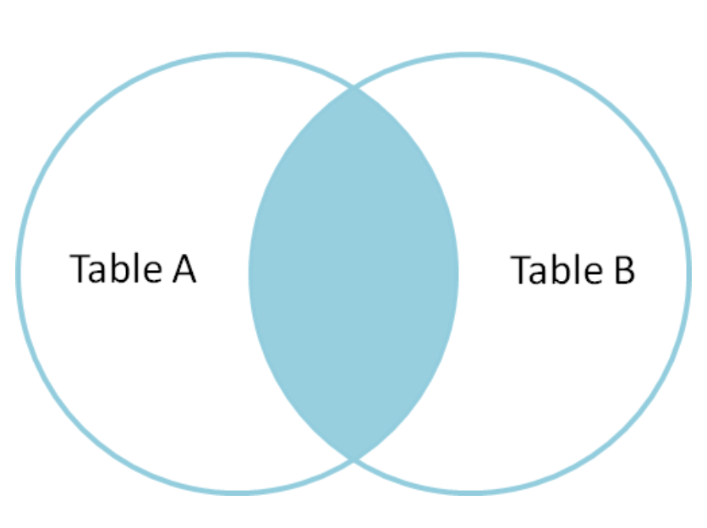
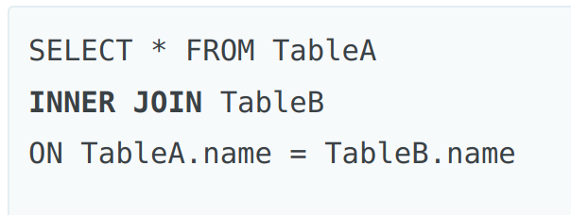
Inner Join
Tables have columns of information you need to know the names of the columns so that you can figure out what needs to match for the join
An Inner Join is going to be where the information on tables A and B match looking at a particular column
This is ONLY where they match
In this case we are looking at the column name in both tables A and B called name
Use case examples:
If we wanted to know patrons of the library who borrowed books in the last 6 months we would look at where patron's table and the books checkouts tables as seen in the example query on slide 1
https://blog.codinghorror.com/a-visual-explanation-of-sql-joins/

Slide 8
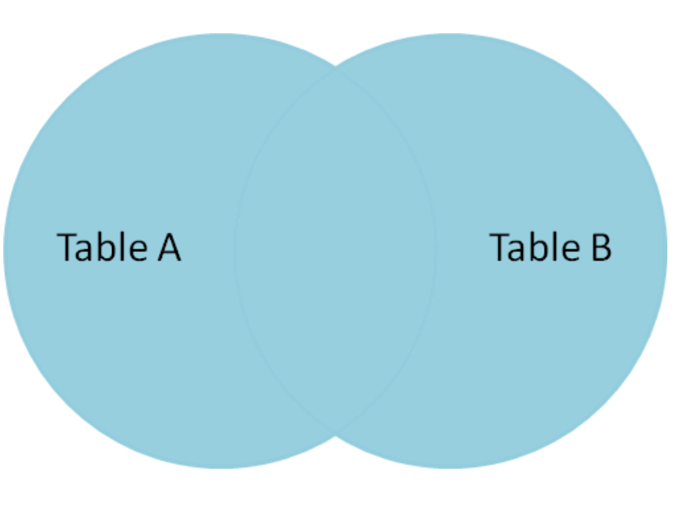
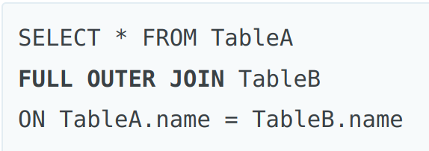
Outer Join
Tables have columns of information you need to know the names of the columns so that you can figure out what needs to match for the join
An Outer Join is all information in both tables including where they match
In this case we are looking at the column name in both tables A and B
This is less common then inner joins
Use case examples:
We can take a books table and a patrons table and look at both, not all books have been checked out, not all patrons have borrowed a book, but we want all the data anyway, anything not filled in will have a NULL value
https://blog.codinghorror.com/a-visual-explanation-of-sql-joins/

Slide 9
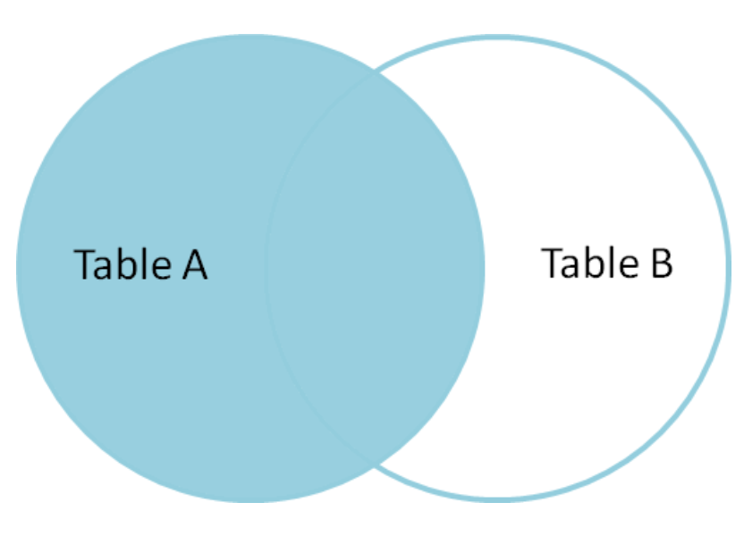
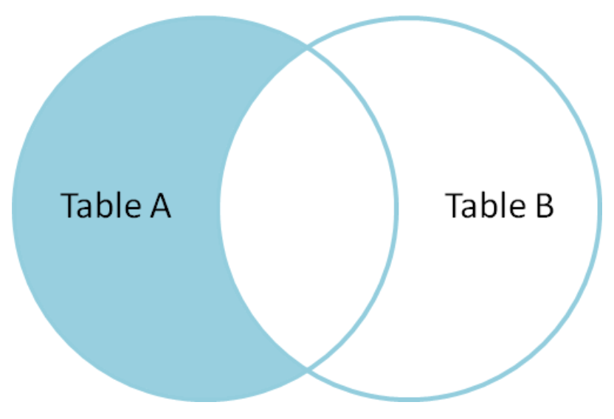
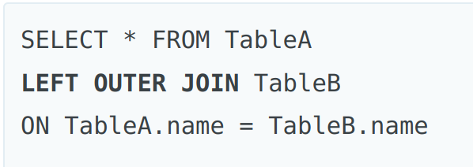
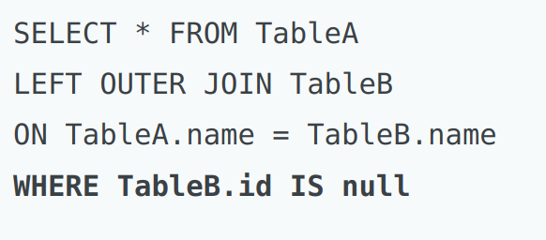
Left and Right Joins
Left Outer Join is all results from Table A including where there are matches on Table B
Left Outer join where we won't have the matches from Table B is done by using the WHERE to specify that if Table A has matches in Table B mark it as null in our results
We can do the same for the right with Right Outer Join by switching the order of the tables in the query
https://blog.codinghorror.com/a-visual-explanation-of-sql-joins/

Slide 10
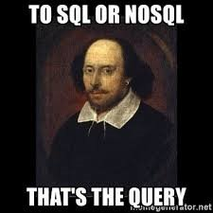
Where to go next for more SQL
There are places you can go to get case studies to trial your SQL knowledge
https://8weeksqlchallenge.com/case-study-1/
https://advancedsqlpuzzles.com/
https://www.hackerrank.com/domains/sql
There are references you can look at
https://www.w3schools.com/sql/sql_quickref.asp
There are cheat sheets you can use for refresh
https://web.archive.org/web/20240119141821/https://learnsql.com/blog/sql-basics-cheat-sheet/#inner-join

Slide 11
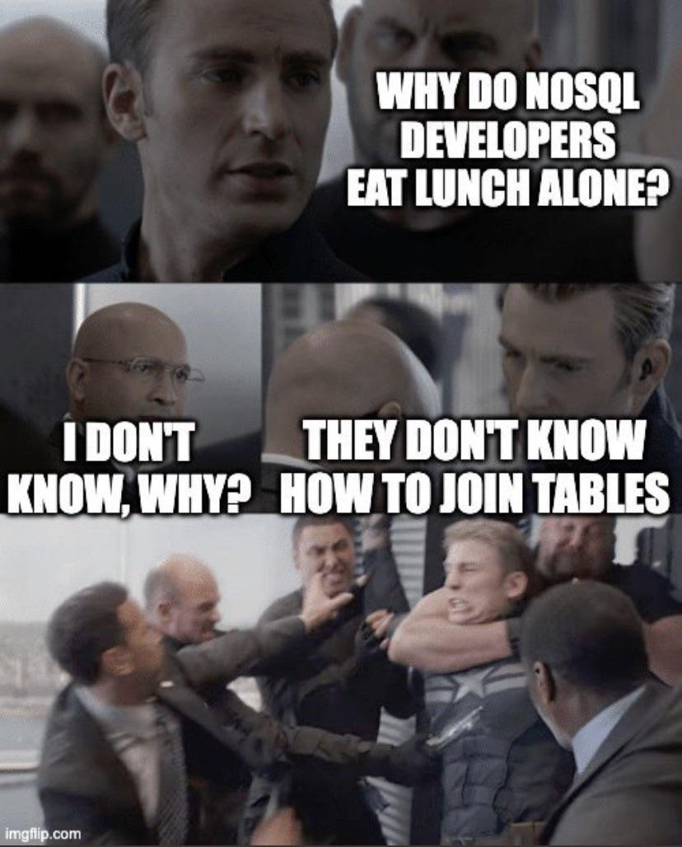
NoSQL
NoSQL stands for Not Only SQL
NoSQL databases are not relational
Examples of NoSQL databases are document, key-value, graph, or wide-column stores
Many people argue NoSQL is more flexible and scalable then SQL based Databases
NoSQL can handle unstructured and semi-structured data
Examples of implementations are MongoDB, Redis and Cassandra
An example of where you might want to use NoSQL instead of SQL might be if you wanted a database of images or videos (Large Items)

Slide 12
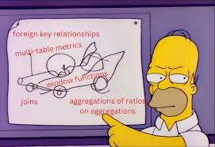
Table Relationships
Relationships for tables are how connect to each other, so you can organize and link data across multiple tables
There are 4 types of relationships, One-to-one, One-to-many, Many-to-many, and self-referencing

Slide 13
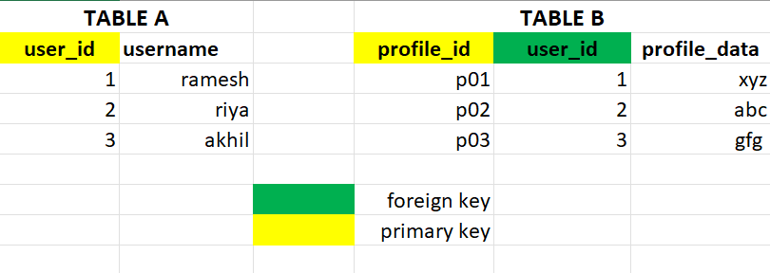
One-to-one relationships
If we assume two tables, Table A and Table B
One-to-one means for each record in Table A, there is only one reference for Table B
The same is true for each record in Table B, there is only one reference for Table A.
Example: There is only one person associated with each Employee profile
https://www.geeksforgeeks.org/relationships-in-sql-one-to-one-one-to-many-many-to-many/

Slide 14
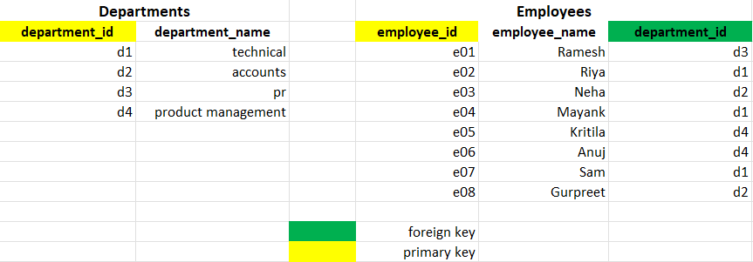
One-to-many relationships
Assume Tables A and B again
Each record for Table A can have multiple associations with Table B. But each record for Table B only has 1 association with Table A
Example: There are many employees, but only a few departments
https://www.geeksforgeeks.org/relationships-in-sql-one-to-one-one-to-many-many-to-many/

Slide 15
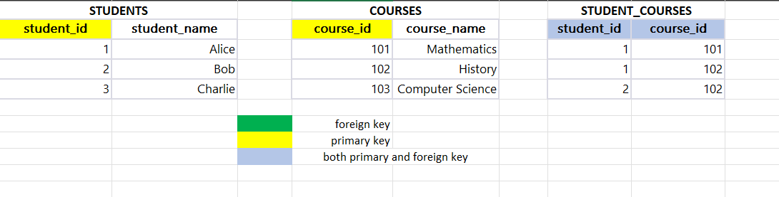
Many-to-many
Assuming Tables A and B again
Each record in table A can have multiple associations with Table B, and that goes both ways
Example: There are many students, in many classes
https://www.geeksforgeeks.org/relationships-in-sql-one-to-one-one-to-many-many-to-many/

Slide 16
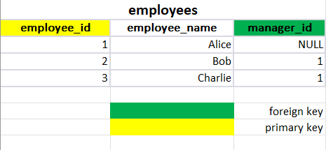
Self-referencing
A table foreign key references it's primary key
Sometimes referred to as a recursive relationship
Example: All employees are staff, including managers, but each employee also has a manager
https://www.geeksforgeeks.org/relationships-in-sql-one-to-one-one-to-many-many-to-many/

